Slide 1
Calibration our solution
Model was optimized for log-loss which suppose to be optimal in calibrated scores. But Model training was done with weights, different sampling
Recalibrating model with isotonic regression on test samples (no weight, subsampling, etc)
Plotting calibration plot

Slide 2
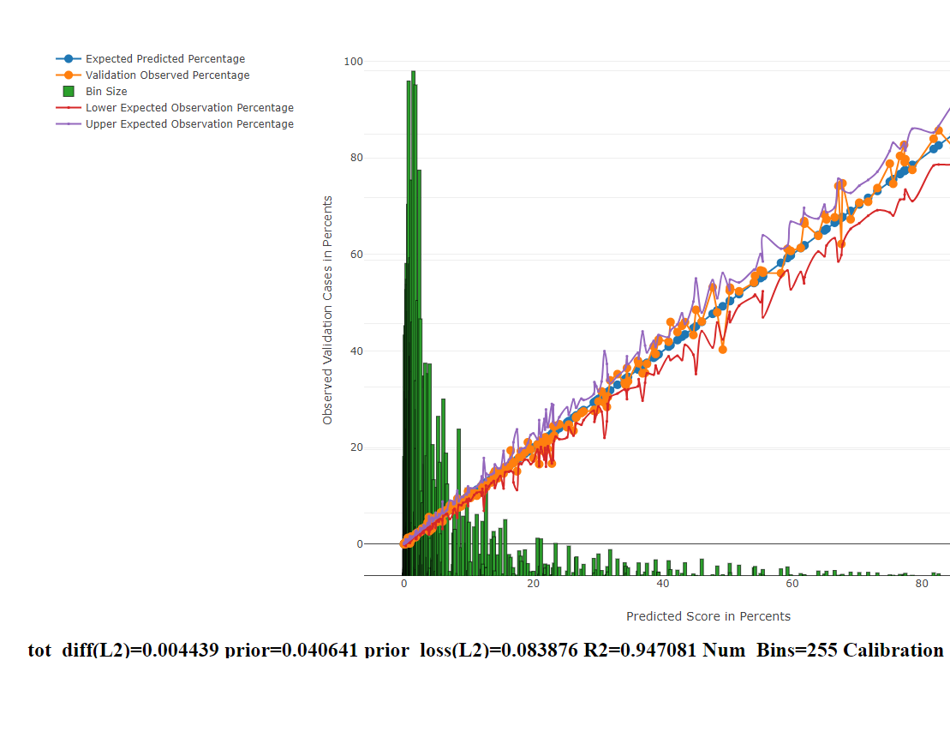
Example result

Slide 3
Calibration Questions
What metrics should we use to assess good calibration?
We want the calibration to work “well” on “different” population – different external confounders – like different air pollution
We have about 2-3 different datasets
Another simpler/easier problem – assess the PPV beyond score cutoff
We are using “SEER” incidence of the population based on sex,age to reweight the examples to the desired incidence in the performance evaluation

